Slide 1
Inferences regarding fixed & random effects
Gemma Wallace & Neil Yetz
02/19/2020

Slide 2
Fixed vs Random effects
Fixed Effects:
Interested in the effects of the factors uniquely in our study
If we repeated the experiment, the levels would be the same
The inferences you make will only be applied to each of the factors included in your ANOVA
Random Effects:
Levels of the factors are treated as if they are randomly sampled from a broader population
Estimates the variance among treatments (And assumes there are unmeasured groups)
The inferences you make will be applied to a wider set of the population

Slide 3
Fixed or Random?
Surveying students at CSU to to understand CSU student opinions
Collecting wait time data from separate medical centers to estimate how long on average people wait in medical centers
Studying fertilizers with the intent of making statements about fertilizers in general

Slide 4
Fixed or Random?
Surveying students at CSU to to understand CSU student opinions
Collecting wait time data from separate medical centers to estimate how long on average people wait in medical centers
Studying fertilizers with the intent of making statements about fertilizers in general

Slide 5
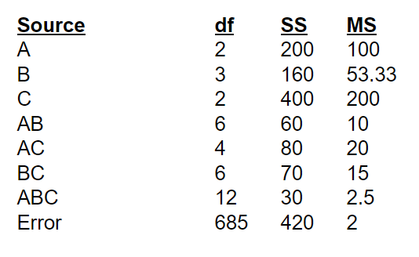

Slide 6
How many cells?

Slide 7
How many cells?
A: 2_{DF} + 1 = 3 groups
B: 3_{DF} + 1 = 4 groups
C: 2_{DF} + 1 = 3 groups
3*4*3 = 36 total cells

Slide 8
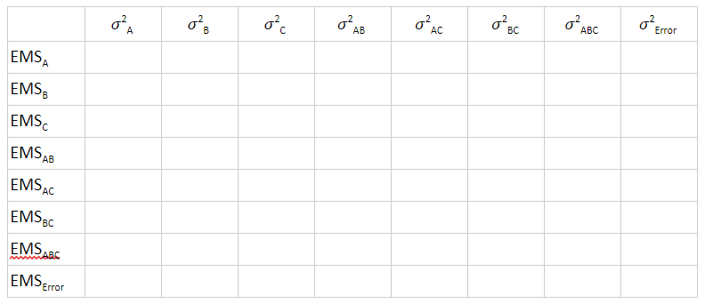
Create EMS tables: A,B,C are all fixed

Slide 9
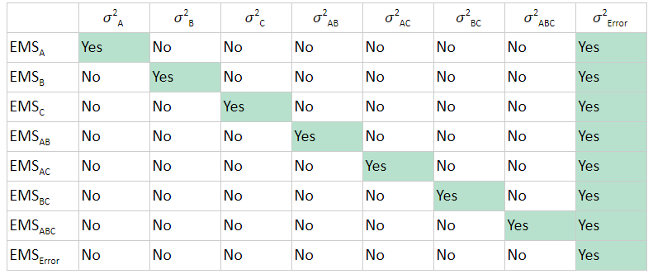
Create EMS tables: A,B,C are all fixed

Slide 10
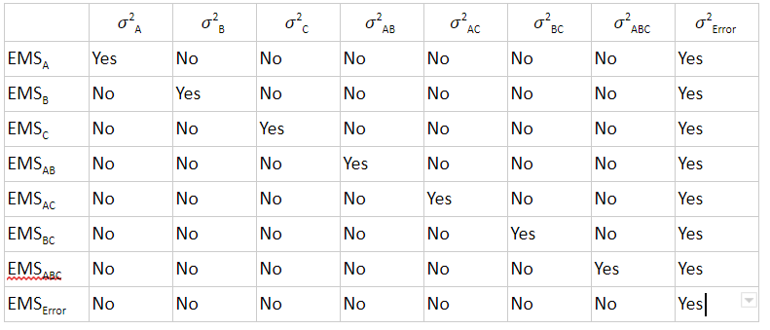
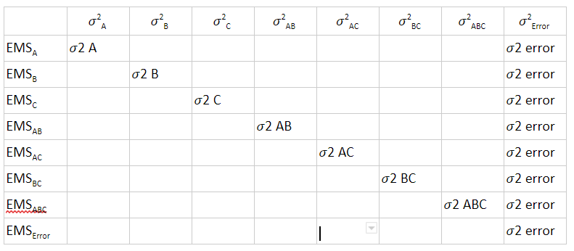
Identify Equations: A,B,C are all fixed

Slide 11
Identify variance components for each effect
Write the equations that include the components that go into the EMS for each effect.
EMS_{A} = nqr 𝜎²A + 𝜎²error
EMS_{B} = npr 𝜎²B + 𝜎²error
Each effect is weighted by the number of observations for each effect
n = number of subjects/cell
p = levels of A
q = levels of B
r = levels of C
Hint: weight each effect by the variables that are NOT included in that effect!

Slide 12
Solve for the 𝜎²_{error} for each effect
1) The best estimate for the 𝜎²_{error} is the mean square residual for the error
Get this value from your ANOVA table
2) The MS for each effect represents the EMS for that effect. You can then solve for the 𝜎² of each effect.
-e.g., EMS for A is estimated by 100

Slide 13

F-Values
You can then use the following formulas to solve for the F and Quasi F ratios for each effect.
E.g.,

Slide 14
Fixed vs. Random Effects
Remember from the lecture, the components that go into each EMS effect are different when the model is fully fixed, fully random, or mixed (i.e., has both fixed and random effects)!

